Slide 1
The Nethersole Church of England Academy and Nursery
Our distinctive Christian character
Let your light shine
Matthew 5:16

Slide 2
The Nethersole Church of England Academy and Nursery
Greeting –
Jesus, the Light of the World is here.
Response:
Lord Jesus Shine upon us
Let your light shine
Matthew 5:16

Slide 3
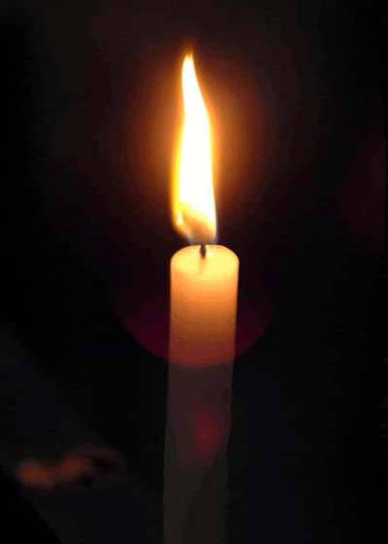
The Nethersole Church of England Academy and Nursery
Light a candle – A tiny light, a tiny prayer, for God’s blessing everywhere.

Slide 4
The Nethersole Church of England Academy and Nursery
Our school vision is - we are here to bring out the God colours and let our light shine bright.

Slide 5
The Nethersole Church of England Academy and Nursery
Our value this half term is:-
Everyone matters; everyone is loved; everyone shines
Treat everyone you meet with dignity. Love your spiritual family. Revere God. 1 Peter 2:17

Slide 6
Our school prayer
Lord God in heaven,
We play together,
We learn together,
We try hard to get things right.
Lord, love us all,
And let our light shine bright.
In our school,
We read about you,
Of all your strength and might.
Lord keep us safe,
And let our light shine bright.

Slide 7
God you are our friend and Saviour,
We want to be a delight,
Lord watch over us,
And let our light shine bright.
Many colours make a rainbow,
Many children make our school,
Together an awesome sight,
Lord, love us all,
And let our school shine bright.
Amen.

Slide 8
The Nethersole Church of England Academy and Nursery
Sending
As we walk out of this space,
let God see your light shine. (Toby)

