Slide 1
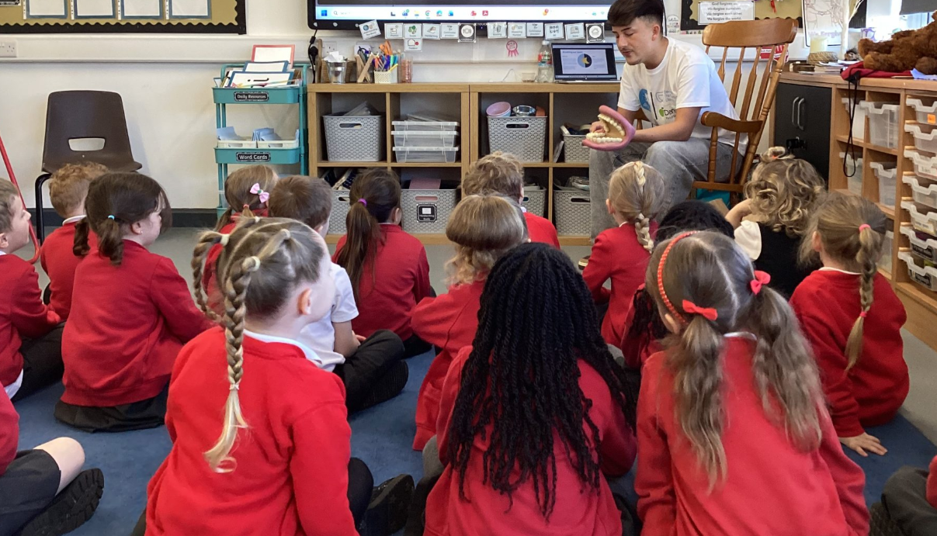
SEND
Information Report
A guide for families
The Nethersole Church of England Academy
“To be light, bringing out the God-colours in the world.”
Reviewed October 2026
Notes:
[Sources]
- SEND-Information-Report-2026.docx, The Nethersole Church of England Academy, reviewed October 2026.
- Visual on this slide was generated with Microsoft Copilot.

Slide 2
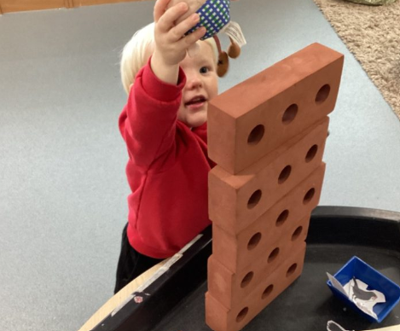
Welcome
What families can expect from our school
Every child is unique. We want every pupil to learn, grow and thrive.
Our commitment
We will value your child’s strengths.
We will identify barriers to learning.
We will make reasonable adjustments.
We will listen to you and your child.
We will review the difference support is making.
Notes:
[Sources]
- SEND-Information-Report-2026.docx, The Nethersole Church of England Academy, reviewed October 2026.
- Visual on this slide was generated with Microsoft Copilot.

Slide 3
Who should I speak to?
Please contact us whenever you have a concern
1. Class teacher
2. SENDCO
3. Headteacher
Your child’s class teacher is usually the best first contact. They can explain how your child is learning and what support is already in place.
Miss Asilah Deakin
Deputy Headteacher and SENDCO
office@nethersole.bdmat.org.uk
01827 892357
If you need further support, you can arrange to speak with the Headteacher – Mrs Goode We operate an open-door approach.
You do not need to wait for a parents’ evening. We can arrange a meeting or telephone call at any time.
Notes:
[Sources]
- SEND-Information-Report-2026.docx, The Nethersole Church of England Academy, reviewed October 2026.
- Visual on this slide was generated with Microsoft Copilot.

Slide 4
What does SEND mean?
Children may need additional or different support in one or more areas
Communication and interaction
Cognition and learning
For example, understanding or using language, communicating with others or managing social interaction.
For example, learning new skills, remembering information, reading, writing or maths.
Social, emotional and mental health
Sensory and/or physical needs
For example, anxiety, emotional regulation, relationships, attention or engagement.
For example, hearing, vision, movement, medical needs or differences in sensory processing.
A child may have needs in more than one area. Support is based on the individual child, not only on a label or diagnosis.
Notes:
[Sources]
- SEND-Information-Report-2026.docx, The Nethersole Church of England Academy, reviewed October 2026.
- Visual on this slide was generated with Microsoft Copilot.

Slide 5
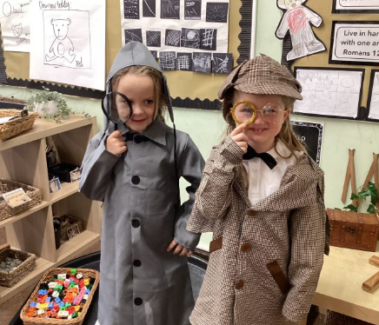
How do we identify needs?
We work with families and look carefully at progress, participation and wellbeing
Notice
Teachers monitor learning and wellbeing and listen to concerns raised by families or children.
Discuss
We talk with you and your child about strengths, needs and what may help.
Act and review
We agree support, check progress and adapt the plan when needed.
Notes:
[Sources]
- SEND-Information-Report-2026.docx, The Nethersole Church of England Academy, reviewed October 2026.
- Visual on this slide was generated with Microsoft Copilot.

Slide 6
How will learning be adapted?
Support should help children take part, make progress and become more independent
Teaching and tasks
Classroom support
Independence
Clear explanations and modelling
Work broken into manageable steps
Adapted resources or recording methods
Extra practice and repetition
Visual prompts and timetables
Practical resources
Small-group or individual guidance
Support with communication and regulation
Helpful scaffolds are used when needed. They are reduced carefully as the child becomes secure and confident.
Notes:
[Sources]
- SEND-Information-Report-2026.docx, The Nethersole Church of England Academy, reviewed October 2026.
- Visual on this slide was generated with Microsoft Copilot.

Slide 7

What support might my child receive?
Our graduated approach means support increases in response to need
Universal support
High-quality teaching and classroom adaptations available to all pupils.
Targeted support
Additional, time-limited small-group or individual support matched to a specific need.
Specialist support
Individualised provision informed by specialist advice and, where appropriate, an EHCP.
Notes:
[Sources]
- SEND-Information-Report-2026.docx, The Nethersole Church of England Academy, reviewed October 2026.
- Visual on this slide was generated with Microsoft Copilot.

Slide 8
The Assess, Plan, Do, Review cycle
A shared process for understanding needs and improving support
1. Assess
2. Plan
3. Do
4. Review
Gather information about strengths, needs and progress.
Agree outcomes, support, responsibilities and review dates.
Put the agreed provision and classroom strategies in place.
Check the impact with the child and family, then adapt as needed.
This cycle may be repeated several times. Evidence from each review helps us decide the next steps. We meet termly with parents, teachers and SENCO to review progress.
Notes:
[Sources]
- SEND-Information-Report-2026.docx, The Nethersole Church of England Academy, reviewed October 2026.
- Visual on this slide was generated with Microsoft Copilot.

Slide 9
Learning plans and targets
How we agree and review personalised support
The plan includes
SMART targets
Family involvement
Your child’s strengths and needs
Personalised outcomes or targets
Strategies and provision
Who will provide support
When progress will be reviewed
Specific
Measurable
Achievable
Realistic
Time-related
Learning plans are discussed with families and reviewed each term. You will receive a copy, and your child’s views will be included.
Notes:
[Sources]
- SEND-Information-Report-2026.docx, The Nethersole Church of England Academy, reviewed October 2026.
- Visual on this slide was generated with Microsoft Copilot.

Slide 10
What is an Education, Health and Care Plan?
An EHCP is a legal document for children and young people who need coordinated, specific provision
Who can request an assessment?
An EHCP sets out
A parent or carer can ask the Local Authority to carry out an EHC needs assessment. The school, usually through the SENDCO, can also make a request.
• the child and family’s views and aspirations
• the child’s special educational needs
• agreed outcomes
• the education, health and social care provision required
What happens next?
The Local Authority considers the evidence and decides whether an assessment and then an EHCP are needed. We will support families through the process.
Notes:
[Sources]
- SEND-Information-Report-2026.docx, The Nethersole Church of England Academy, reviewed October 2026.
- Visual on this slide was generated with Microsoft Copilot.

Slide 11
Working with specialist services
Specialists may help us understand needs, recommend strategies or provide further assessment
Educational Psychology
Educational Psychologists
Communication
Speech and Language Therapists
Physical and sensory
Occupational Therapy, physiotherapy, hearing and vision teams
Specialist teaching
Integrated Disability Service and Specialist Teaching Service
Health
GPs, school nursing and paediatric services
We will explain why a referral or specialist involvement is being considered and keep you informed.
Notes:
[Sources]
- SEND-Information-Report-2026.docx, The Nethersole Church of England Academy, reviewed October 2026.
- Visual on this slide was generated with Microsoft Copilot.

Slide 12
Wellbeing, inclusion and school life
Every child should feel safe, valued and able to participate
Wellbeing
Trips and activities
Transition
We have a caring and inclusive environment
The support is matched to individual needs
We have a family support worker and she can be involved where appropriate
We have regular communication with families
Reasonable adjustments are made so pupils with SEND can take part. Risk assessments and visits to venues are completed when needed.
We share relevant information and plan support when children start school, change class, move between key stages or transfer to another setting.
Notes:
[Sources]
- SEND-Information-Report-2026.docx, The Nethersole Church of England Academy, reviewed October 2026.
- Visual on this slide was generated with Microsoft Copilot.

Slide 13
How do we know support is helping?
We look at the whole child, not only attainment scores
We gather evidence
We listen
We respond
Class assessment
Progress towards learning-plan targets
Intervention records
Small-step progress measures
Observations and work samples
Your child’s views
Your views as a parent or carer
Feedback from staff
Advice from specialists
Continue successful support
Adapt strategies or provision
Agree new targets
Seek further advice when needed
Notes:
[Sources]
- SEND-Information-Report-2026.docx, The Nethersole Church of England Academy, reviewed October 2026.
- Visual on this slide was generated with Microsoft Copilot.

Slide 14
If you have a concern or complaint
Please raise concerns early so we can work together
1
2
3
4
5
Class teacher
SENDCO
Headteacher
Governors
Department for Education
We aim to respond sensitively, fairly and as quickly as possible. The school’s complaints policy gives full details of the formal process.
Notes:
[Sources]
- SEND-Information-Report-2026.docx, The Nethersole Church of England Academy, reviewed October 2026.
- Visual on this slide was generated with Microsoft Copilot.

Slide 15
Key words families may hear
A short guide to common SEND language
SEND
Special educational needs and disabilities
SENDCO
The teacher who leads SEND across the school
SEN Support
Additional or different help provided through the school’s graduated approach
EHCP
Education, Health and Care Plan
Reasonable adjustment
A change that reduces a disadvantage for a disabled pupil
Intervention
Planned additional teaching or support for a specific need
Notes:
[Sources]
- SEND-Information-Report-2026.docx, The Nethersole Church of England Academy, reviewed October 2026.
- Visual on this slide was generated with Microsoft Copilot.

Slide 16

We are here to help
Please talk to us if you have questions about your child’s learning, development or wellbeing.
Miss Asilah Deakin
Deputy Headteacher and SENDCO
office@nethersole.bdmat.org.uk
01827 892357
Notes:
[Sources]
- SEND-Information-Report-2026.docx, The Nethersole Church of England Academy, reviewed October 2026.
- Visual on this slide was generated with Microsoft Copilot.

